Slide 1
Assignment 1: Playing Games: Ms Pac Man vs Ghost Team
Prepared by: Ho Kim Chuan
Matric No: 17068452/1
Lecturer: Prof Dr. Loo Chu Kiong

Slide 2
Target Outcome:
By using the base UI code and Ghosts controller in demo script, write an AI controller to control the Pac Man using Tree Search Method.
Achieve better outcome than the controller of the demo code given in the Spectrum.
(Demo code link: github.com/kfkok/TreeSearchMsPacMan)
Record a Demo video of the working controller created.
Submission Link for the Demo Video: https://drive.google.com/drive/folders/1CYRj0Pkz3EZmNVuuhPQish639AbodVZg

Slide 3
Methodology
A tree-based searching algorithm is used to search for the highest score for every possible actions at every game state.
The complexity of method is affected by the height of the search tree,h and the branching factor, b of each step.
There are many branching factor of for each step, hence we set a max limit up to 5 to limit the computation of each step.
Perform searching at the junction as searching on a straight route is less informative.

Slide 4
Pseudocode of the methodology in controller
EvaluateMove(move, game,step)
ForwardGame(move, game)
If step == Max_height :
Return score
Highestscore = -inf
For nextMove in UP,DOWN,LEFT,RIGHT do
clonedGame = clone(game)
Score = evaluateMove(nextMove,clonedGame,step+1)
Highestscore = max(score, highestScore)
return highestScore

Slide 5
Average Performance:
Average Score: 9050, Max:12960
Average Survival Stage : Level 2- 3
Average T: 1950

Slide 6

Demo

Slide 7
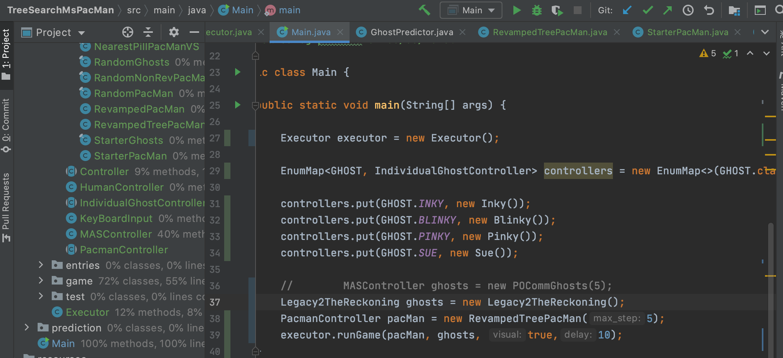
Testing Demo(DIY)

Slide 8
THANK YOU
~THE END~

